Slide 1


Introduction to Artificial Intelligence
Artificial Intelligence (AI) is a rapidly advancing field that aims to create intelligent systems capable of perceiving, learning, and problem-solving like humans. This presentation will provide an overview of the foundations, key concepts, and real-world applications of this transformative technology.
by Zeeshan Zafar

Slide 2
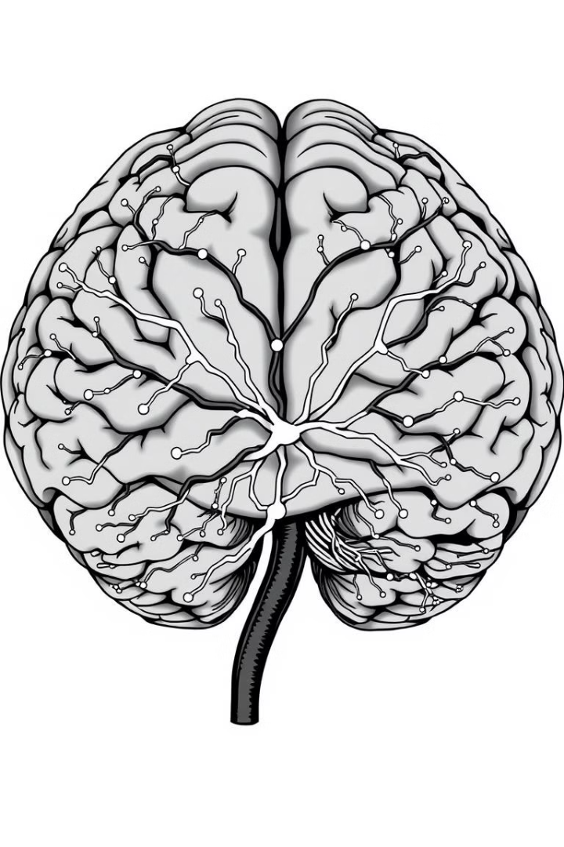
Understanding Intelligence
1
Definition of Intelligence
2
Human Intelligence
Human intelligence involves a wide range of cognitive abilities, such as perception, reasoning, memory, and decision-making.
Intelligence is the ability to acquire and apply knowledge and skills to solve problems and adapt to new situations.
3
Key Traits:
Logical reasoning
Learning from experience
Perception and adaptation to the environment
Examples: Problem-solving, decision-making in daily life

Slide 3
What is Artificial Intelligence?
Definition
Goal
Approach
Artificial Intelligence (AI) is the field of computer science that aims to create intelligent systems that can perform tasks that typically require human intelligence, such as perception, learning, and problem-solving.
The ultimate goal of AI is to develop systems that can think, learn, and act autonomously, much like humans do, but with the potential for greater speed, precision, and efficiency.
Learning: Using data for training (e.g., Machine Learning)
Reasoning: Drawing conclusions based on data
Self-correction: Improving performance over time

Slide 4
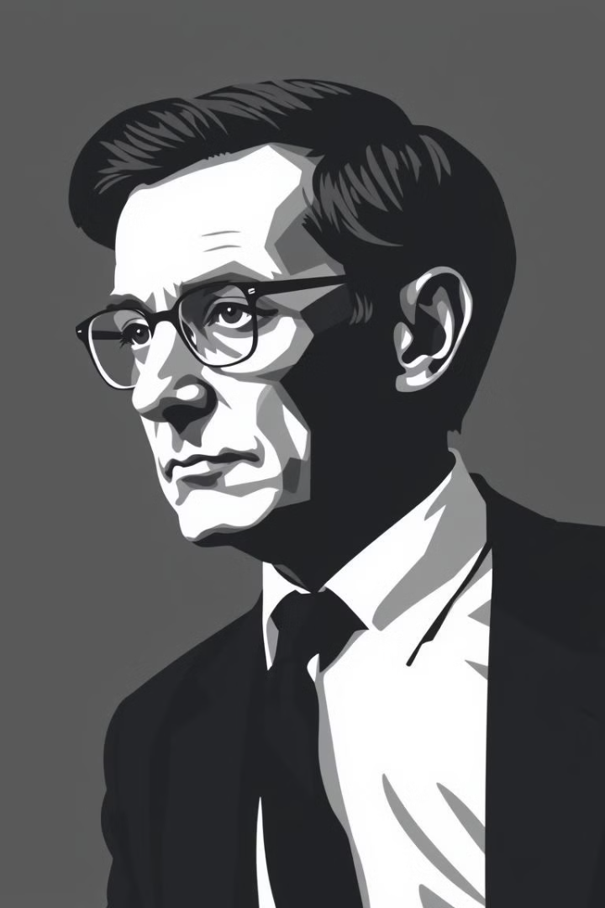
Alan Turing and the Intelligent Machine
1
Turing's Vision
In the 1950s, Alan Turing proposed the idea of a "thinking machine" - a computer that could mimic human intelligence and perform tasks that require reasoning and problem-solving.
2
Turing Test
Turing also developed the Turing Test, a way to determine if a machine can exhibit intelligent behavior that is indistinguishable from a human.

Slide 5

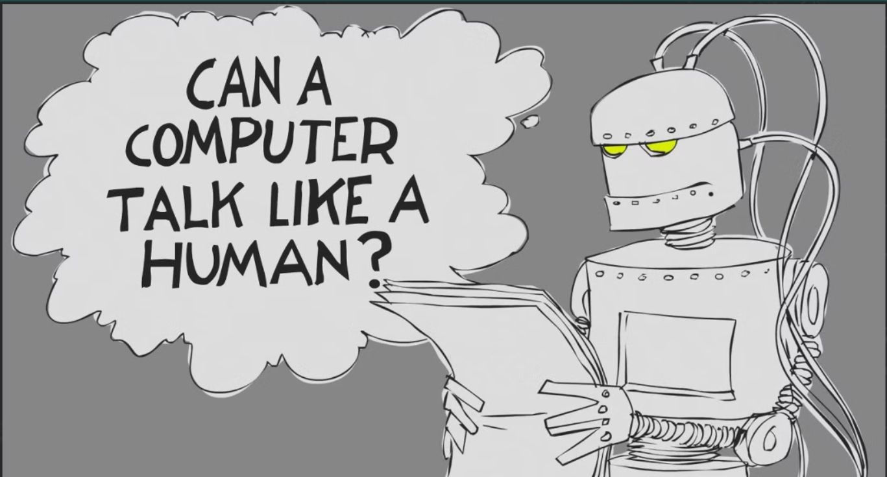

Slide 6
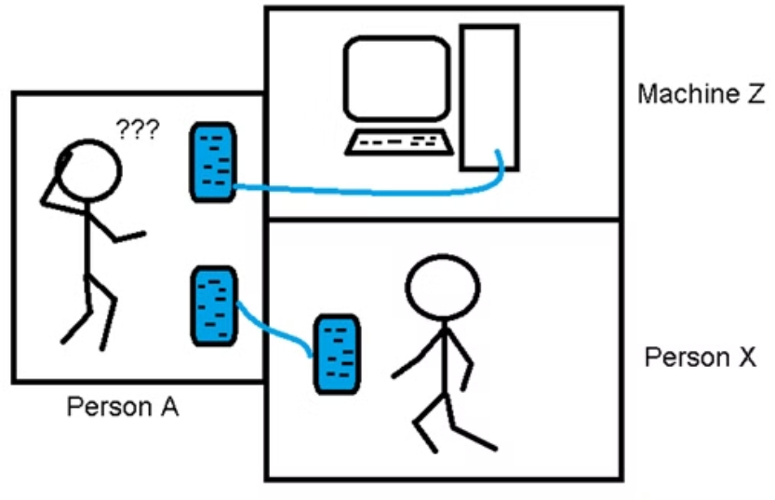
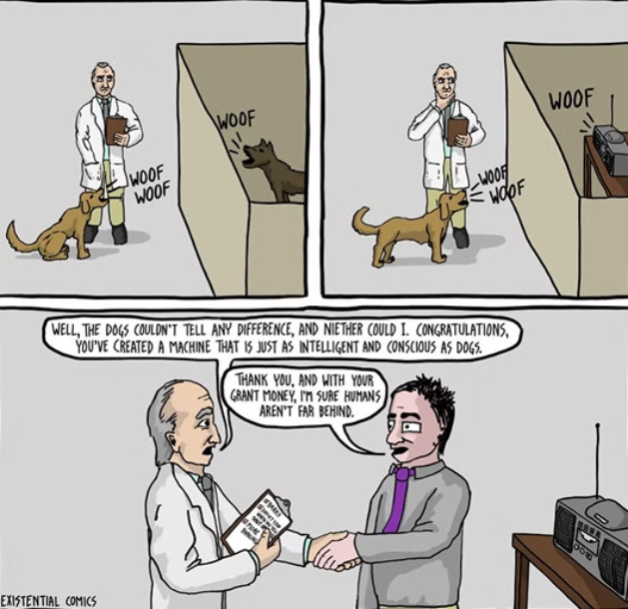
Turing Test
Is it man or machine? Can you really tell?

Slide 7
Levels of AI: Weak AI and Strong AI
Weak AI
Strong AI
Weak AI, or narrow AI, refers to AI systems designed to perform specific tasks or a limited range of tasks, such as playing chess or recognizing images.
Strong AI, or artificial general intelligence (AGI), is the goal of creating AI systems that can match or exceed human intelligence across a wide range of cognitive tasks and adapt to new situations.
Example: 2 player games where you can play with computer

Slide 8
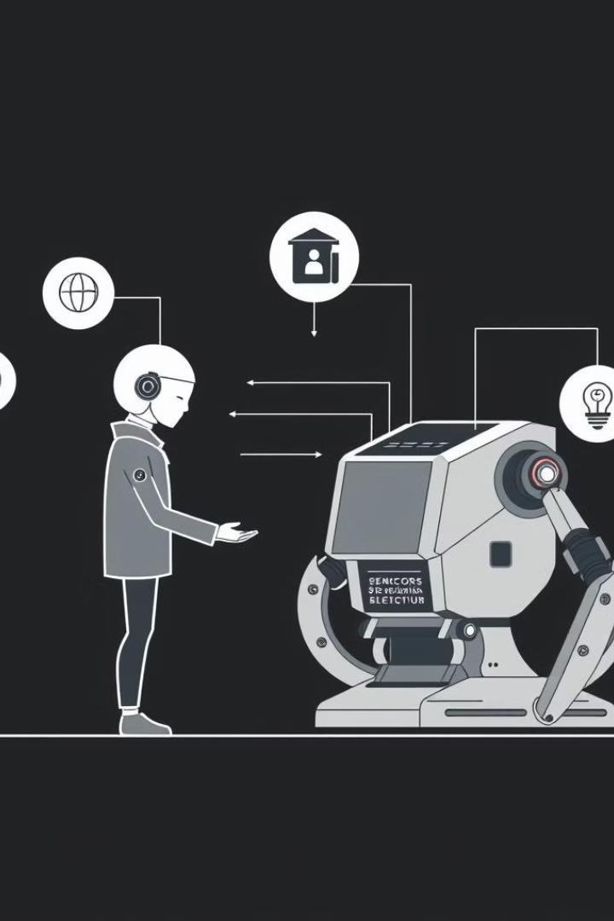
Agent
Environment
Preceptors
Sensor
Actuators
Machine Brain

Slide 9
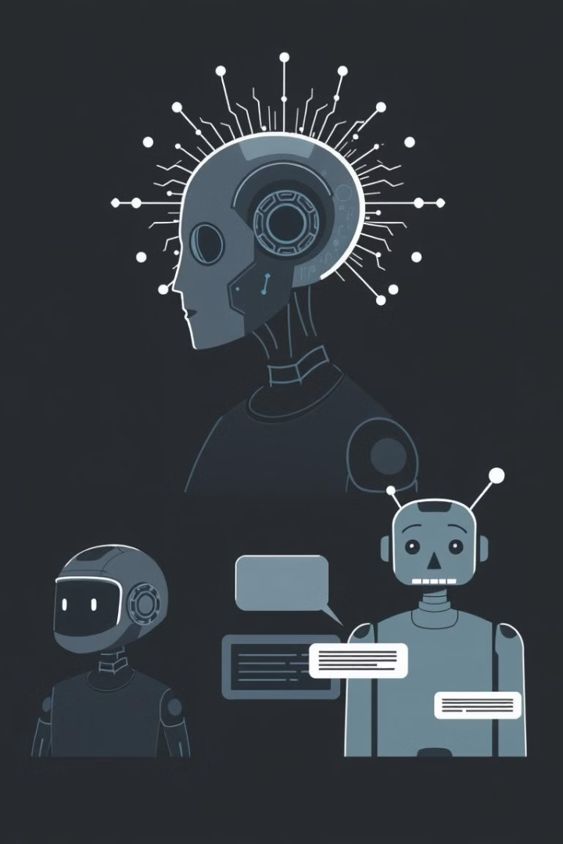





Types of Agents
Reflex Agent:
Model Based Agent:
React directly to the environment
Use knowledge of the world for decisions
Goal Based Agent:
Utility Based Agent:
Act to achieve specific objectives
Optimize for the best outcomes, considering preferences
Learning Agent:
Continuously improve through learning

Slide 10
Rule-Based Systems and Machine Learning
Rule-Based Systems
Machine Learning
Deep Learning
Traditional AI systems that use pre-programmed rules and logic to make decisions and solve problems.
AI techniques that enable systems to learn and improve from experience, without being explicitly programmed, through the use of algorithms and statistical models.
A subset of machine learning that uses artificial neural networks with multiple layers to process and learn from complex data, like images and natural language.

Slide 11
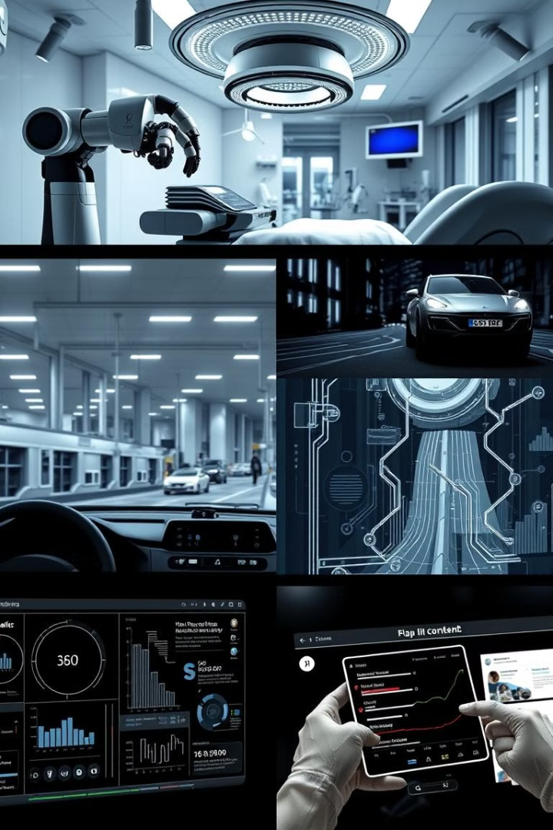




Applications of AI in the Real World
Healthcare
AI is used for disease diagnosis, drug discovery, and personalized treatment planning.
Transportation
Self-driving cars, traffic optimization, and drone delivery are some of the AI-powered transportation applications.
Robotics
AI enables robots to perceive, learn, and interact with their environment, transforming industries like manufacturing and logistics.
Smart Home
AI-powered virtual assistants, home automation, and predictive maintenance are revolutionizing the way we live at home.

Slide 12

The Future of AI: Opportunities and Challenges
1
Opportunities
AI has the potential to drive breakthroughs in fields like scientific research, healthcare, and education, improving lives and solving global challenges.
2
Challenges
Ethical concerns around the use of AI, such as privacy, bias, and the potential displacement of human jobs, require careful consideration and regulation.
3
Collaboration
The successful development and deployment of AI will require close collaboration between researchers, policymakers, and the wider public to ensure its benefits are maximized and risks are mitigated.

